Slide 1
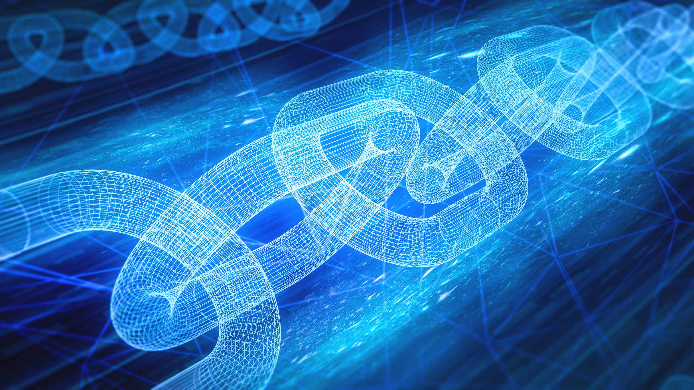
WHAT
is
BLOCKCHAIN

Slide 2
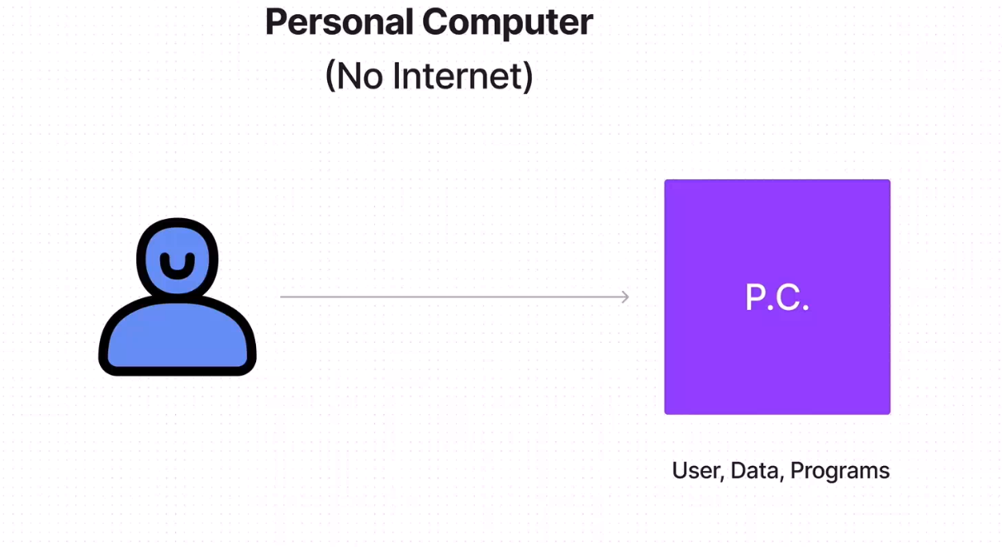


Slide 3
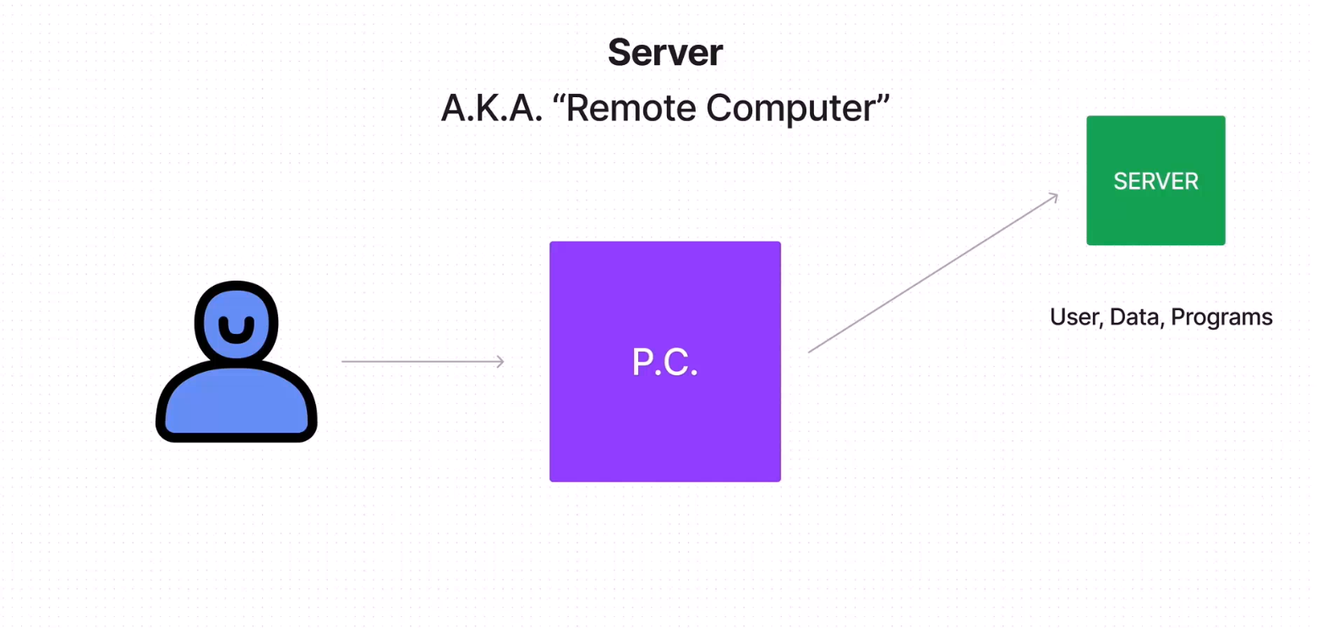

Slide 4
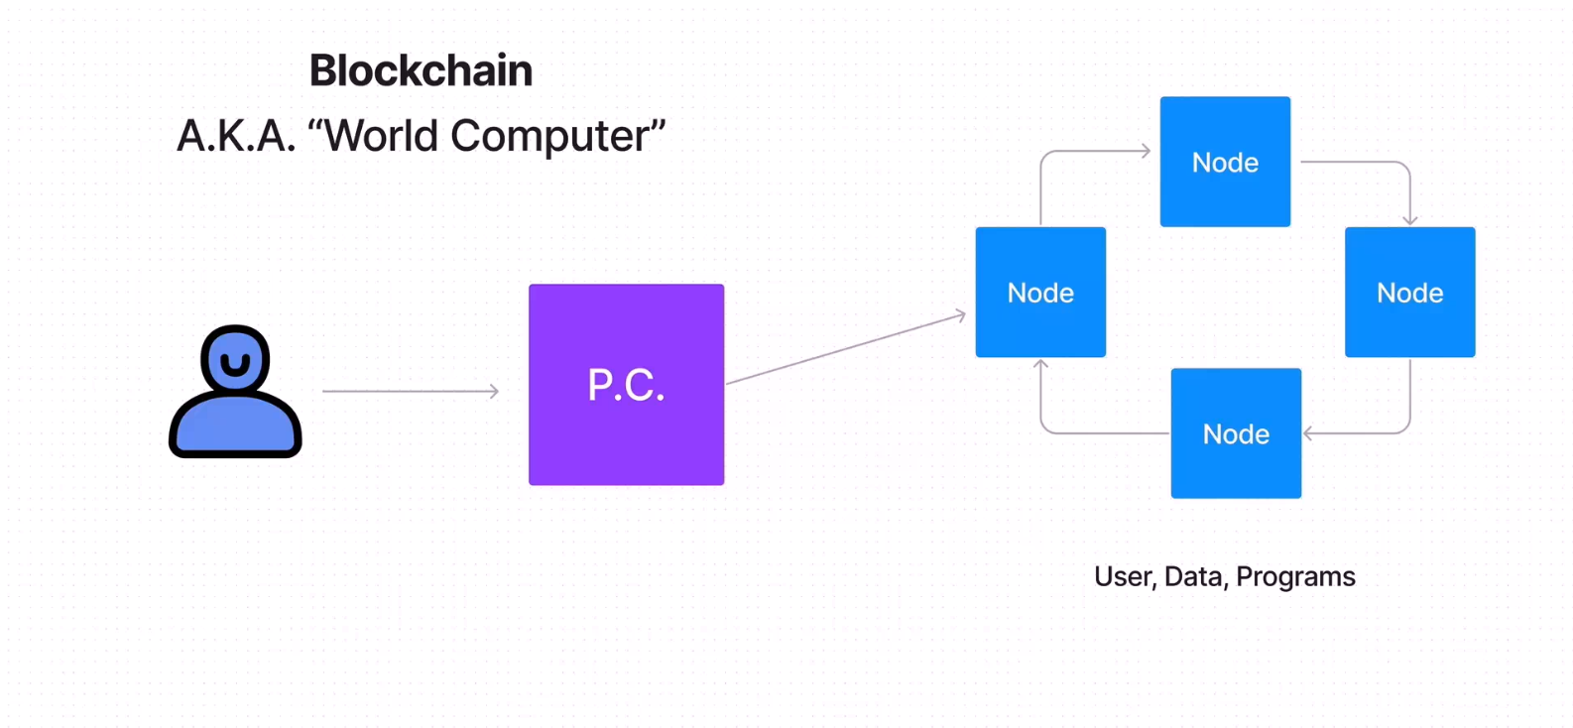

Slide 5
What is a Blockchain?
(World-wide Computer)
1.
Public Network
2.
Shared Database
3.
Runs Programs

Slide 6
Public Network
1.
Open Access
2.
User of Network
3.
Accounts / Wallet
4.
Node Connected

Slide 7
Shared Database
1.
Distributed on Nodes
2.
Transactions
3.
Immutable
4.
Blocks
5.
Public Ledger

Slide 8
Runs Programs
(Worldwide Computer)
1.
Distributed on Nodes
2.
Scripts
3.
Smart Contracts

